Slide 1
Data-Informed Decision-Making in the Film Industry: An Analytical Study
Group 8

Slide 2
Data-Driven Insights for Sinema's Success
Sinema, a new Kenyan movie studio, is poised to contribute vibrant and compelling stories to the cinematic landscape.
To ensure Sinema's success and maximize its impact, our strategies must be informed by a deep understanding of the global and local film market.
This presentation outlines our analysis of key film market data, focusing on maximizing Return on Investment (ROI) – a measure of profitability that tells us how much profit a film generates for every dollar invested.

Slide 3
Business Understanding
The primary business objective is to determine the most financially viable movie genres to guide the studio's production portfolio. This requires addressing the following key questions:
What movie genres demonstrate the strongest financial performance, as measured by worldwide gross revenue?
How does budget influence the profitability of different genres?
What strategic recommendations can be derived from the data analysis to guide investment decisions and ensure the studio's financial success?

Slide 4
Objectives
The main objective of the study is to analyze recent trends within the film industry using a comprehensive set of datasets.
The key objectives are:
1.Quantify Movie Profitability- Use financial data (production budgets and worldwide gross) to compute Return on Investment (ROI) and identify the most and least profitable films.
2.Analyze Movie Ratings- Explore ratings data to understand if and how factors such as runtime, publisher influence critical scores and genre correlate to movie ratings.
3.Find blockbuster movies globally- We aim to find movies that performed exceptionally not only domestically but also worldwide using the worldwide_gross data
4.Investigate the runtime vs movie rating- Find out whether the average runtime of a movie has any influence on the movie ratings.

Slide 5
Data Understanding: Sources and Characteristics
The primary data sources include
The Movie Database (TMDb): This database provided a broad range of movie information, including genre classifications and potentially other descriptive features.
The Numbers: This source offered detailed budget and revenue data for a large number of films, crucial for our profitability analysis.
Rotten Tomatoes: This platform provided movie review data, offering insights into audience and critic reception. We utilized both overall review scores and potentially additional metadata.
Box Office Mojo: This source contributed data on gross earnings, providing another perspective on the financial success of films.

Slide 6
Dataset | Source | Entries | Key Columns
tn_movie_budgets | The Numbers | 5782 | movie,production_budget,domestic_gross,worldwide_gross
boom_movie | Box Office Mojo | 3387 | title,domestic_gross,foreign_gross,year
tmdb_movies | The Movie Database (TMDb) | 26517 | genre_ids,original_title,popularity,vote_average,vote_count
rt_reviews | Rotten Tomatoes | 54432 | id,review,rating,fresh,critic,publisher
rt_movie_info | Rotten Tomatoes | 1560 | id,synopsis,rating (MPAA),genre,director,writer,runtime

Slide 7
Methodology
Data Cleaning
Financial data: Removed symbols, converted to numbers.
Movie titles: Standardized spacing & capitalization.
rt_movie_info: Selected key columns, standardized genre & studio, cleaned runtime & box office.
rt_reviews: Converted ratings to numbers, removed missing.
Merged rt_reviews & rt_movie_info on movie ID

Slide 8
Methodology
Data Analysis
Genre Performance: Compared average revenue & ROI across genres.
Budget vs. Earnings: Correlation analysis.
Critic Ratings: Analyzed rating distribution by genre.
Runtime: Explored impact of movie length.
Top 10 Profitable: Compared budget & earnings.
Visualization: Scatter plots, bar plots, box plots.

Slide 9
Initial Analysis:
Top 10 Most Profitable Movies: Production Budget vs. Worldwide Gross
Profitability Disparity: It's immediately clear that the worldwide gross revenue significantly exceeds the production budgets for all 10 movies. This illustrates the immense profitability of these top-performing films.
Budget-Gross Correlation: While all movies show a high return, there isn't a strict correlation between production budget and worldwide gross. Some movies with relatively lower budgets still achieved massive worldwide earnings.
Outliers: "Avatar" stands out with both the highest production budget and the highest worldwide gross, emphasizing its exceptional financial success.

Slide 10
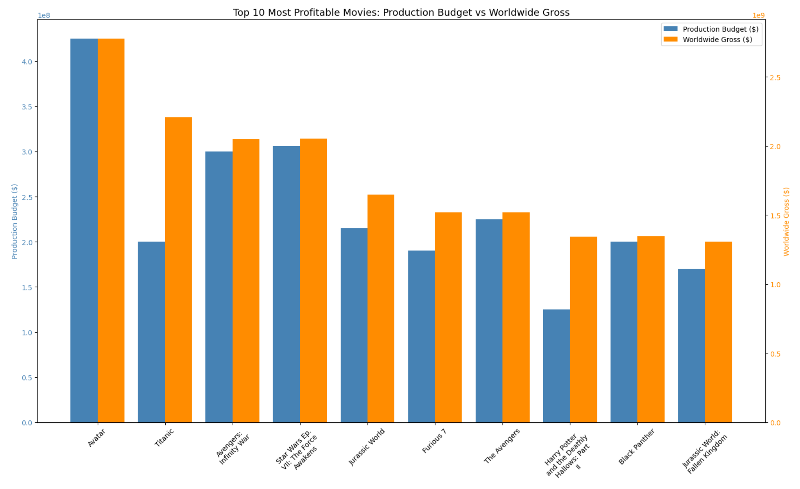

Slide 11
Initial Analysis:
Top 10 movies, ranked by their Return on Investment (ROI)
High ROI with Low Budget: The chart highlights movies with high ROI despite having relatively low production budgets (e.g., "Paranormal Activity," "The Blair Witch Project"). This suggests that Sinema could consider investing in lower-budget films with strong potential for high returns.
ROI vs. Budget: The visualization allows Sinema to compare the production budget and ROI. For example, "Avatar" has a very high budget, but its ROI, while good, is not the highest among these top 10 ROI films.

Slide 12
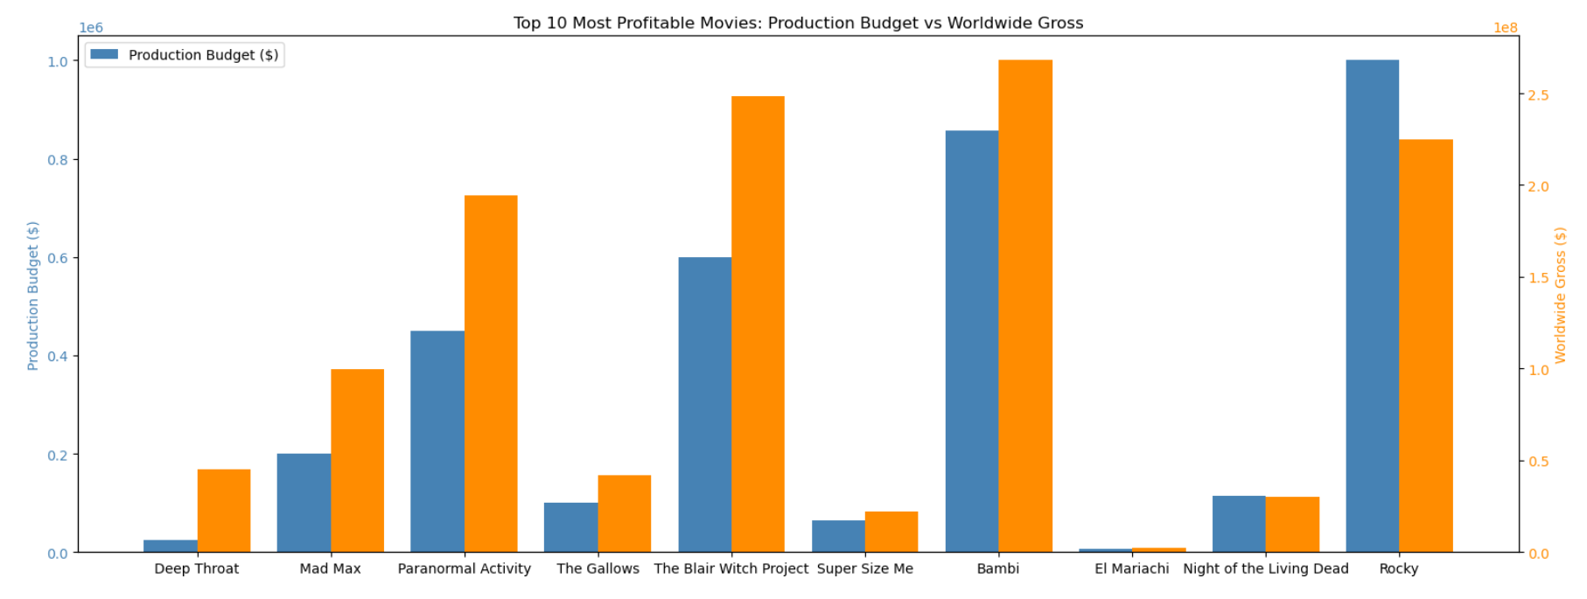

Slide 13
Initial Analysis:
Scatter Plot,Bar Plot, Box Plot
The scatter plot shows a general positive correlation between a movie's production budget and its worldwide gross revenue. This means that, on average, movies with higher budgets tend to earn more at the box office.
This bar chart highlights the top 10 highest-grossing movies. These films represent the peak of commercial success in the movie industry.
This box plot compares the distribution of production budgets, domestic gross revenue, and worldwide gross revenue. It shows the range, median, and interquartile range (IQR) for each financial metric.

Slide 14
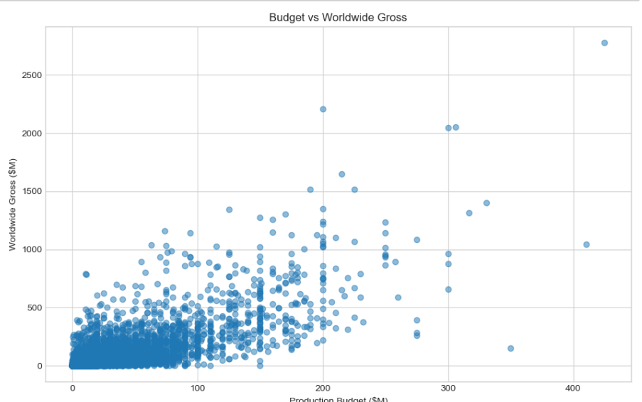

Slide 15
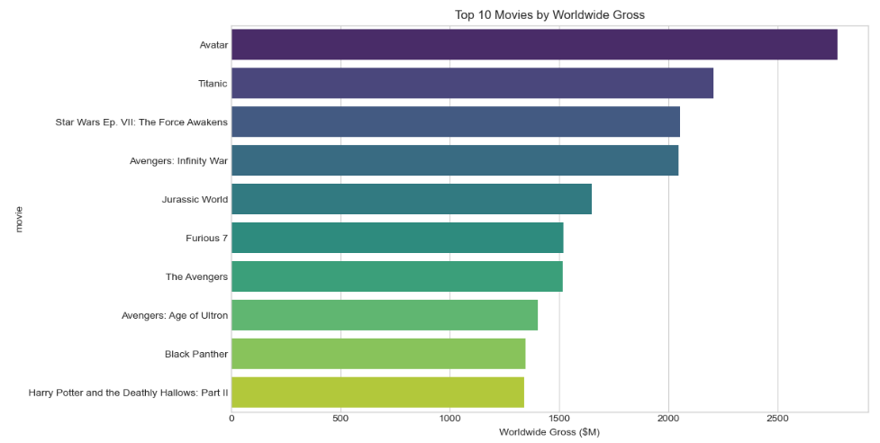

Slide 16
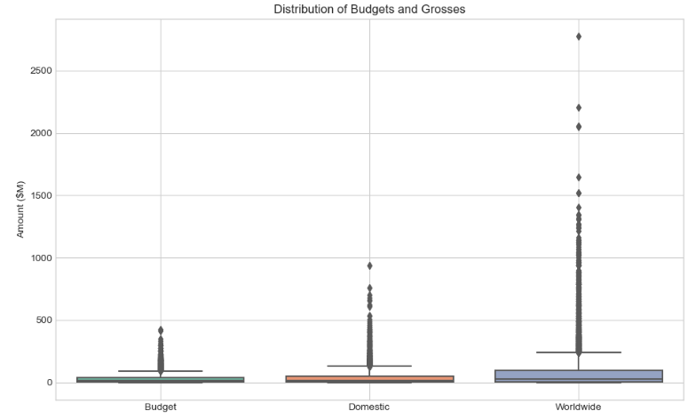

Slide 17
Ratings vs. Runtime Analysis
Data: The analysis uses data from Rotten Tomatoes, combining information from the rt_movie_info and rt_reviews datasets.
Objective: The primary goal is to explore the relationship between movie ratings and runtime, specifically:
  How movie ratings relate to runtime.
  How movie ratings relate to publisher reviews.
Data Cleaning and Merging: The rt_movie_info and rt_reviews datasets are cleaned. The cleaned datasets are merged using the movie id to combine rating information with movie runtime data.

Slide 18
Ratings vs. Runtime Analysis
Scatter Plot: Distribution of Ratings vs. Runtime
Interpretation: The plot suggests that a movie's length doesn't strongly predict its rating. Good and bad movies can come in various lengths.
Bar Plot: Average Runtime by Movie Rating
Interpretation: This plot reinforces the idea that runtime and rating are not strongly related. Movies with higher or lower ratings don't consistently have longer or shorter runtimes.
Box Plot: Distribution of Ratings by Publisher
Purpose: This plot compares the distribution of ratings given by different movie review publishers.

Slide 19
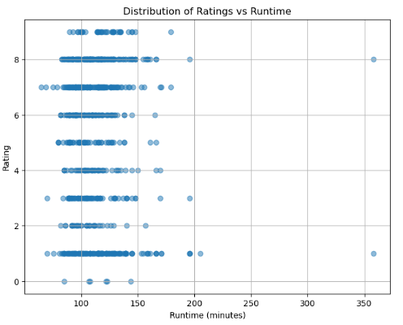

Slide 20
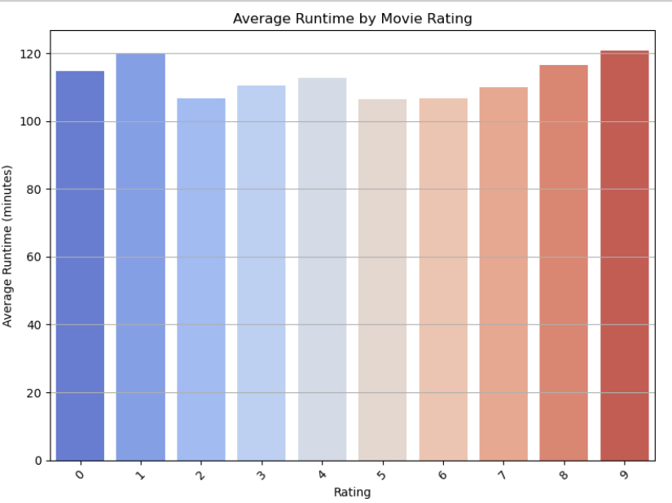

Slide 21
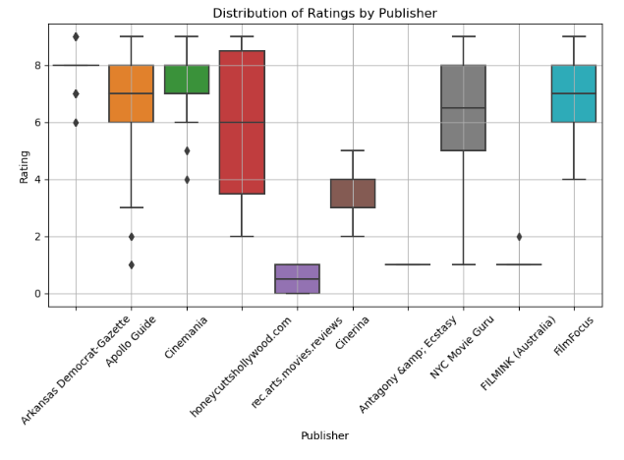

Slide 22
Statistical Analysis
To validate the insights, we've gained from the visualizations, we conduct statistical analyses. These include linear regression and a Z-test.
Linear Regression: Budget vs. Worldwide Gross
Objective: To model the relationship between a movie's production budget and its worldwide gross revenue.
Data: Top 10 most profitable movies (based on ROI) from the tn_movie_budgets dataset.
Results: The plot shows a positive relationship: higher budgets tend to be associated with higher worldwide gross.
R-squared score: 0.73, indicating that 73% of the variance in domestic gross revenue is explained by the production budget for these top 10 ROI movies.

Slide 23
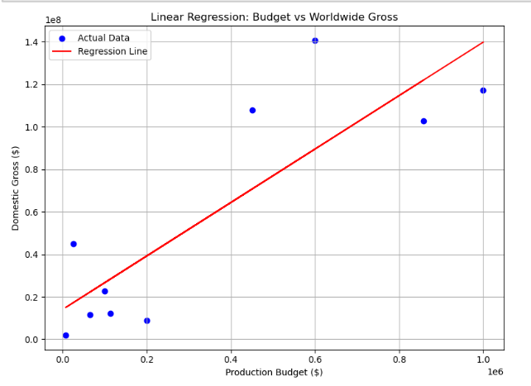
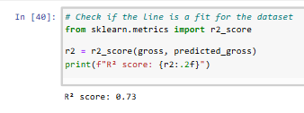

Slide 24
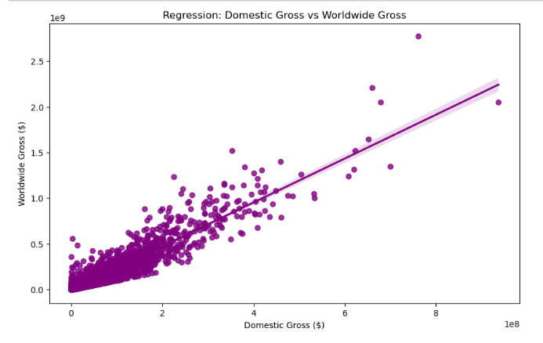

Slide 25
Statistical Analysis
Z-Test
Objective: To test if the mean movie rating is significantly different from 0.
Data: Ratings from the merged movie and review data.
Results: Z-score: 50.68
P-value: 0.0000
Conclusion: We reject the null hypothesis. The mean rating is significantly different from 0.

Slide 26
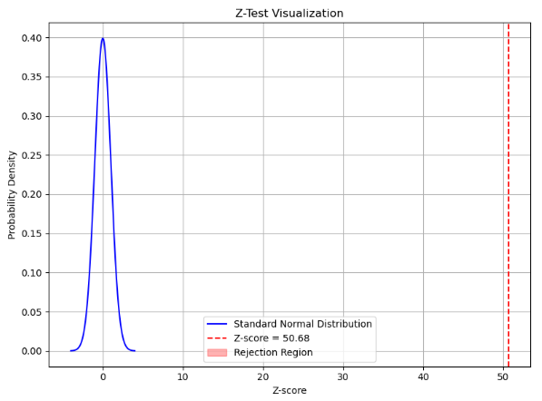

Slide 27
Recomendations
Invest in High-ROI, Lower-Budget Films: Prioritize projects with strong creative concepts and efficient production strategies to maximize returns, even with limited budgets.
Balance Budget with Revenue Expectations: Carefully evaluate a film's potential revenue in relation to its budget, and avoid relying solely on high budgets to guarantee success.
Prioritize Film Quality and Marketing: Focus on developing high-quality films with compelling stories and strong production values, and invest in effective marketing to reach the target audience.

